Slide 1
CSE7000 - INTERNSHIP
A Presentation on
Artificial Intelligence
Under the Supervision of,
Mr. Kavin Mahendhiran , Assistant Professor
Mr. Asad Mohammed Khan , Assistant Professor
Presidency School of Computer Science and Engineering
Presidency University
Student Details
Name | KEERTHI MS
Roll No | 20241CSG0010
Section | 5CSG01
Name of the Program: Computer Science And Technology (AIML)
Name of the HOD: Dr. Pallavi R
Name of the Program Internship Coordinator: Mr. Teja Sirapu
Name of the School Internship Coordinators: Dr. Bhuvaneshwari Patil

Slide 2
Content
About Company or Organization
Working domain or the Technology
Objectives of the work
Methodology Used / Course Description
Results
Conclusion

Slide 3
About Company or Organization
INTERNSPARK TECHNOLOGIES – Company Overview
InternSpark Technologies is a technology and software solutions company.
It provides innovative IT services, software development, and digital transformation solutions.
The company focuses on delivering reliable, scalable, and customer-centric applications.
It offers internship and training programs to help students gain practical industry experience.
Mission: To empower businesses with innovative technology solutions and develop skilled professionals.

Slide 4
Products, Services & Clients
* Products:
Custom business applications
Enterprise software solutions
AI-powered applications
Web and mobile platforms
* Clients:
Startups
Small and Medium Enterprises (SMEs)
Educational Institutions
Business Organizations from various industries
* Services:
Software Development
Web Application Development
Mobile Application Development
AI & Machine Learning Solutions
Cloud and Digital Transformation
IT Consulting and Technical Training

Slide 5
Working domain or the technology
Domain: Artificial Intelligence
Artificial Intelligence (AI) is the field of computer science that enables machines to simulate human intelligence.
During the internship, I gained practical knowledge of AI concepts, machine learning techniques, and real-world applications.

Slide 6
Techniques & Tools:
Machine Learning (ML)
Data Preprocessing and Analysis
Python Programming
Model Training and Evaluation
AI-based Problem Solving
Importance of AI:
Automates repetitive tasks and improves efficiency.
Helps in making data-driven decisions.
Enhances accuracy through predictive analytics.
Powers intelligent applications such as chatbots, recommendation systems, image recognition, and healthcare solutions.

Slide 7
Objectives of the work
Purpose:
To understand the fundamentals of Artificial Intelligence and Machine Learning.
To gain practical experience in developing AI-based solutions.
To apply theoretical concepts to real-world problems.
To improve programming, analytical, and problem-solving skills.
Usage / Applications:
Data analysis and prediction.
Automation of repetitive tasks.
Intelligent decision-making systems.
Chatbots, recommendation systems, image recognition, and healthcare applications.

Slide 8
Methodology Used / Course Description
Steps Followed During the AI Internship:
Learned the fundamentals of Artificial Intelligence and Machine Learning.
Collected and prepared datasets for analysis.
Performed data preprocessing and feature selection.
Built and trained machine learning models.
Evaluated model performance using appropriate metrics.
Tested and improved the models for better accuracy.

Slide 9
Tools Used:
Python
Jupyter Notebook / Google Colab
NumPy
Pandas
Matplotlib
Scikit-learn

Slide 10
Course Description
During the internship, I learned the core concepts of Artificial Intelligence, including:
Introduction to Artificial Intelligence
Python Programming for AI
Data Collection and Preprocessing
Machine Learning Fundamentals
Supervised and Unsupervised Learning
Model Training and Testing
Key Skills Gained:
Data Analysis and Visualization
Machine Learning Model Development
Model Evaluation and Performance Improvement
Problem Solving with AI Techniques
Practical Implementation of AI Concepts

Slide 11
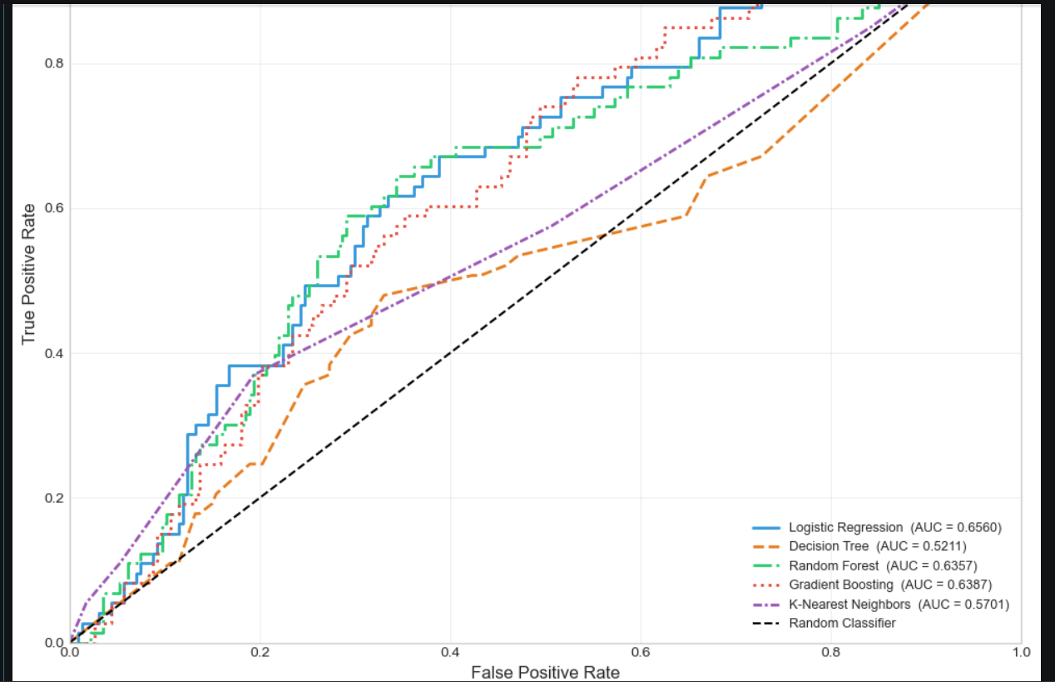
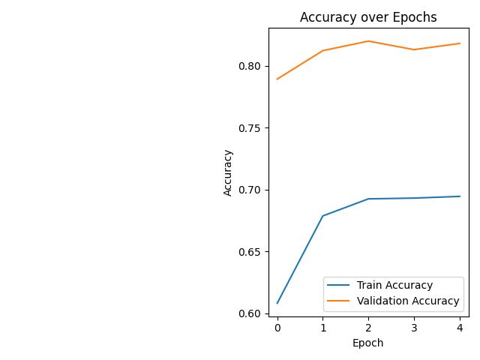

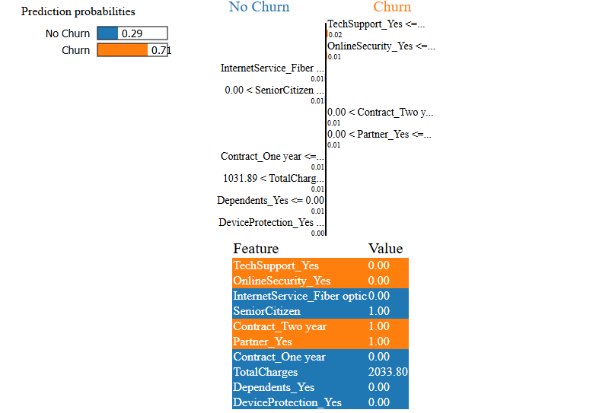
Results
Successfully completed the Artificial Intelligence internship.
Gained hands-on experience in AI tools and machine learning techniques.
Developed and tested AI models using Python
Improved understanding of data preprocessing, model training, and evaluation.
Enhanced problem-solving, analytical, and programming skills.
Successfully completed assigned tasks and projects.

Slide 12
Q&A

Slide 13
Thank you !!

